Slide 1

Feature selection
on large and sparse datasets
Leon Hvastja, Amadej Pavšič
Advisors: Jure Demšar, Blaž Mramor, Blaž Škrlj

Slide 2
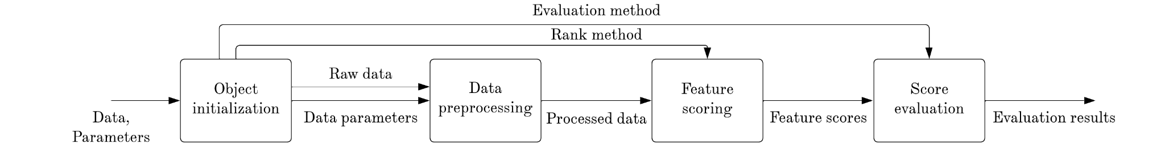
Problem & dataset
Outbrain, web recommendation platform
Sparsity, high cardinality, uninformative features
Efficient feature selection approach
Ranking & evaluation pipeline

Slide 3
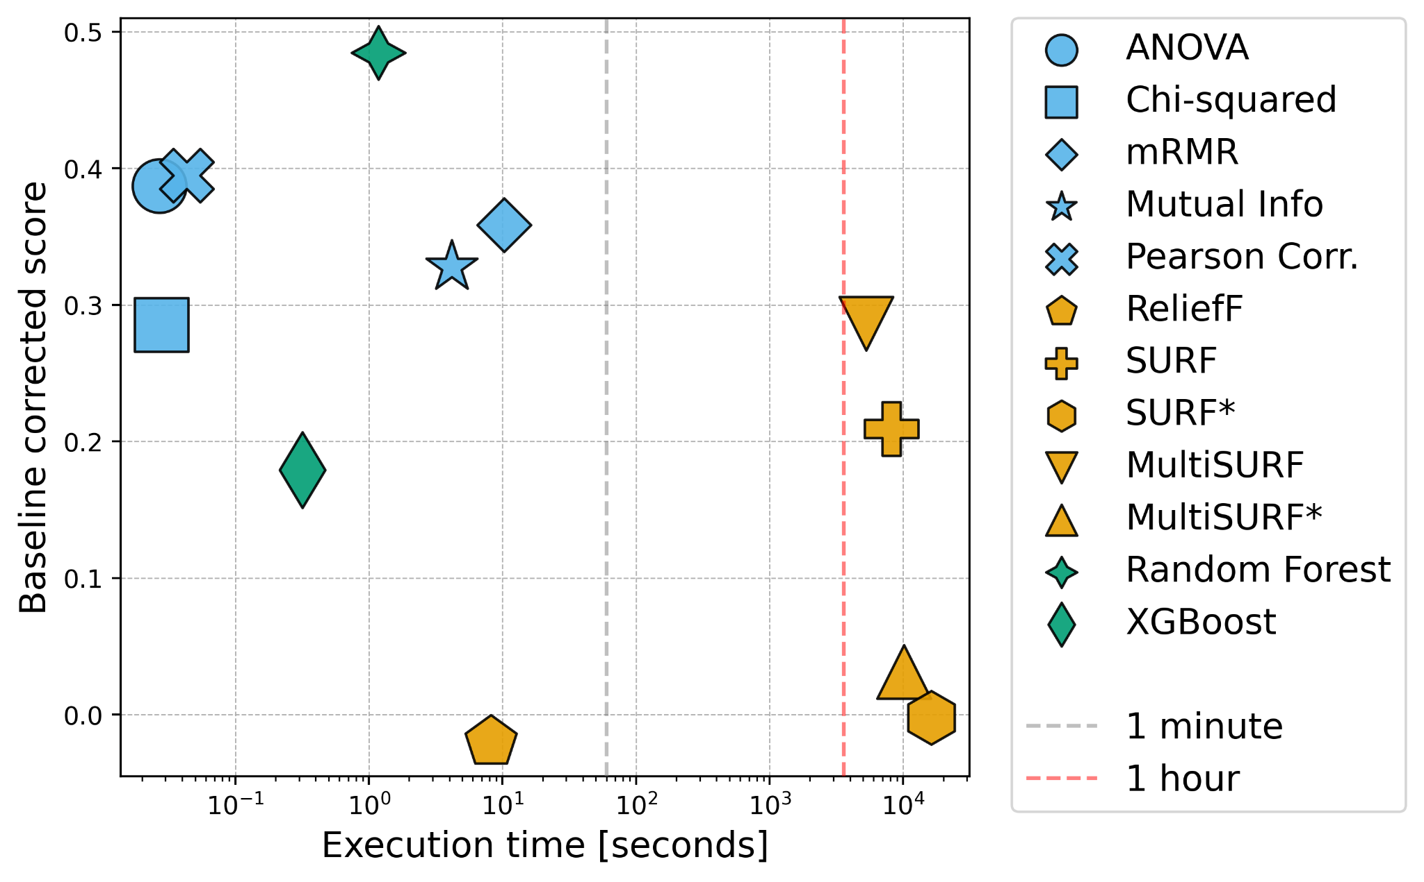
Algorithms
Filter and wrapper methods
Using statistical properties
Relief based approaches
Baseline corrected score
First eliminations

Slide 4
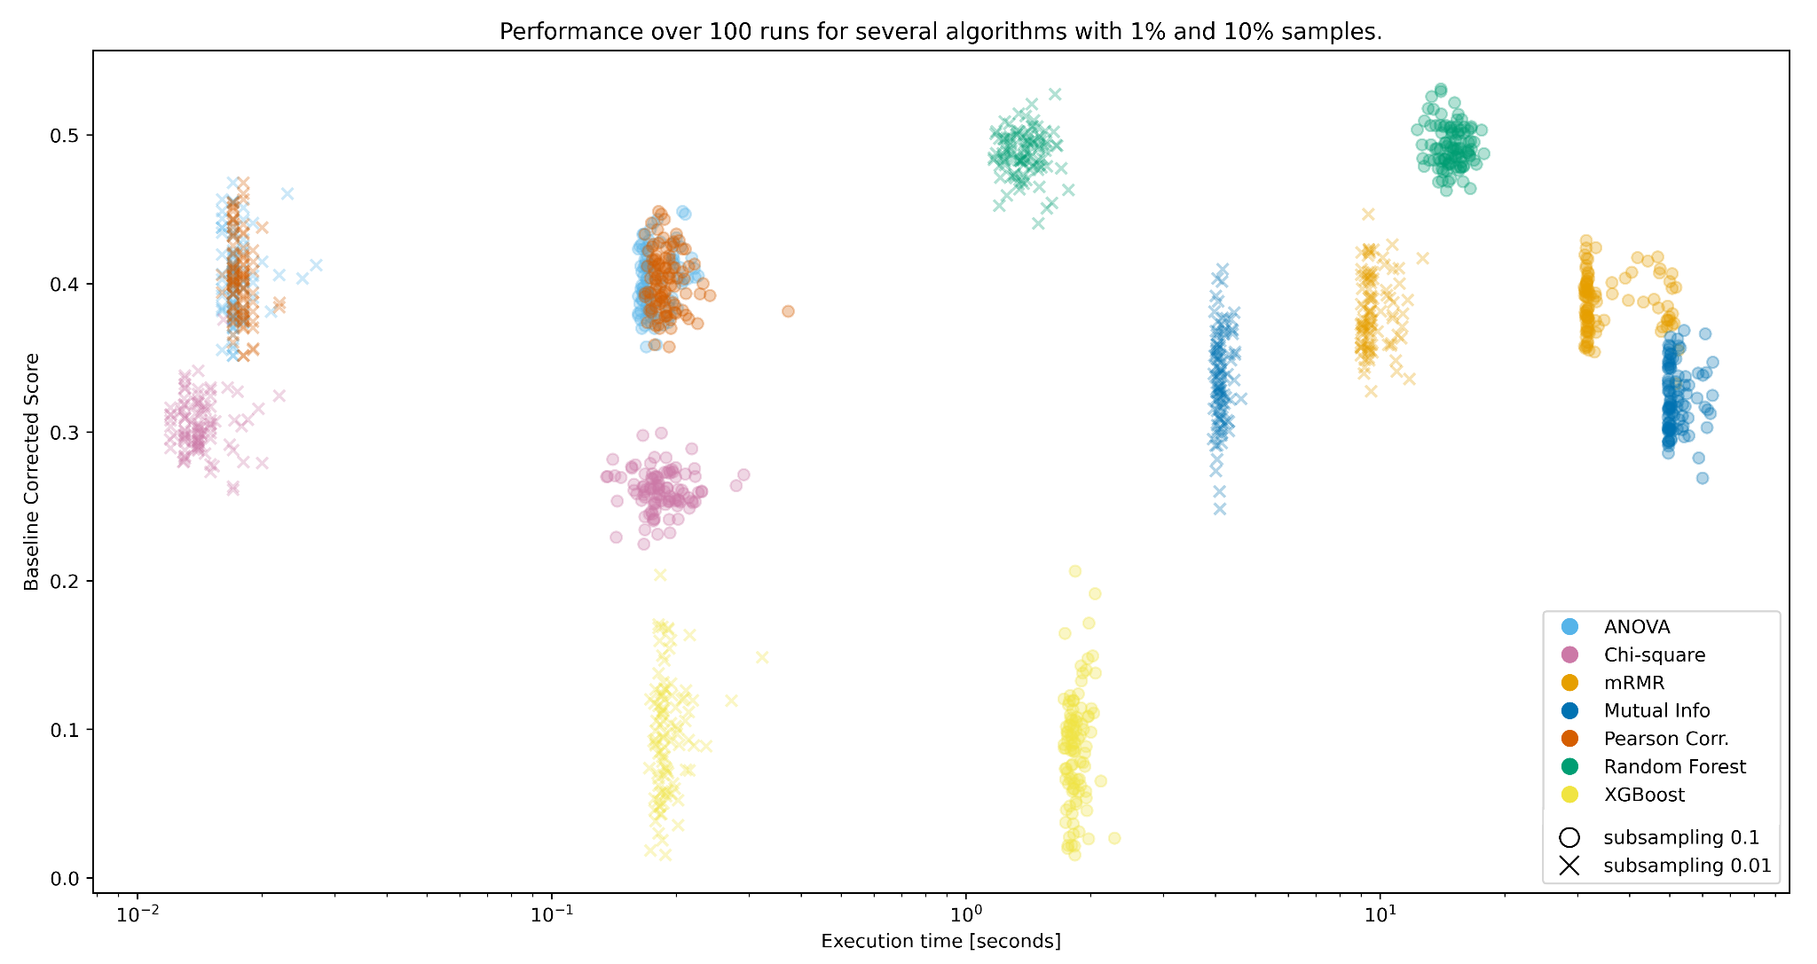

Slide 5
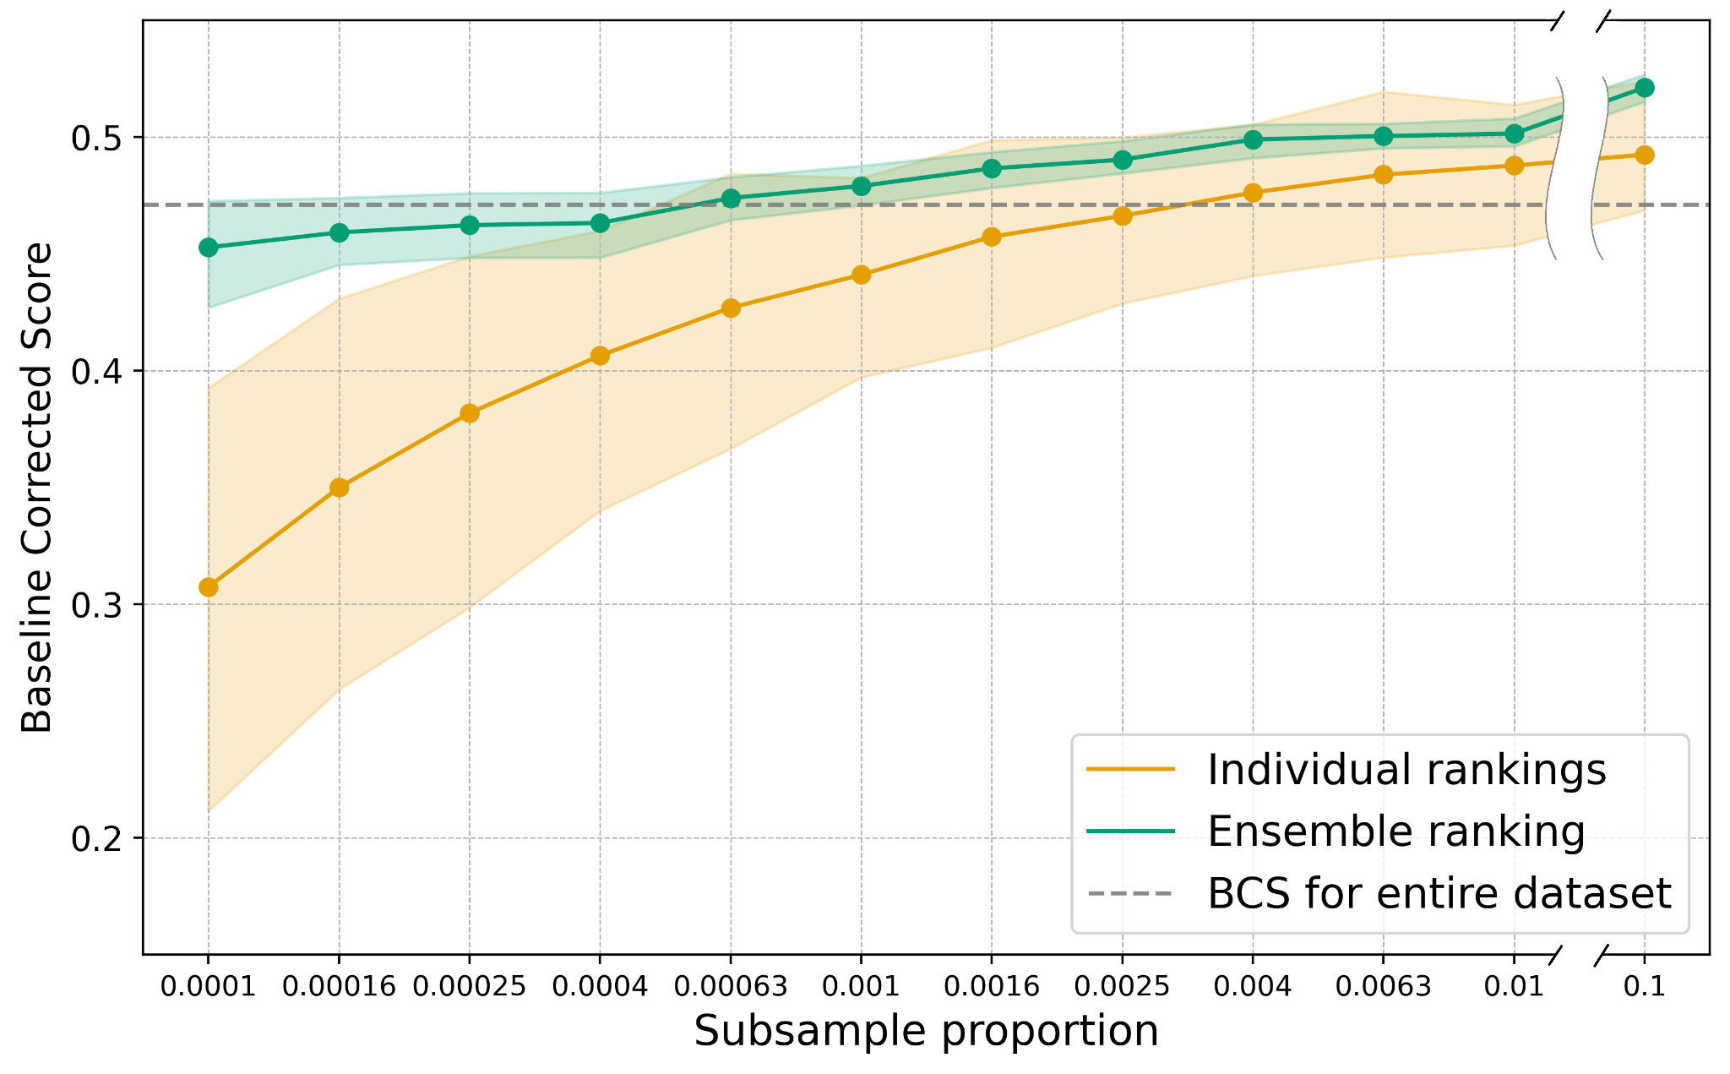
RF performance & ensemble
Subsampling optimization
Ensemble approach
Borda count voting system
Gain for the smallest samples
Performance & variance

Slide 6
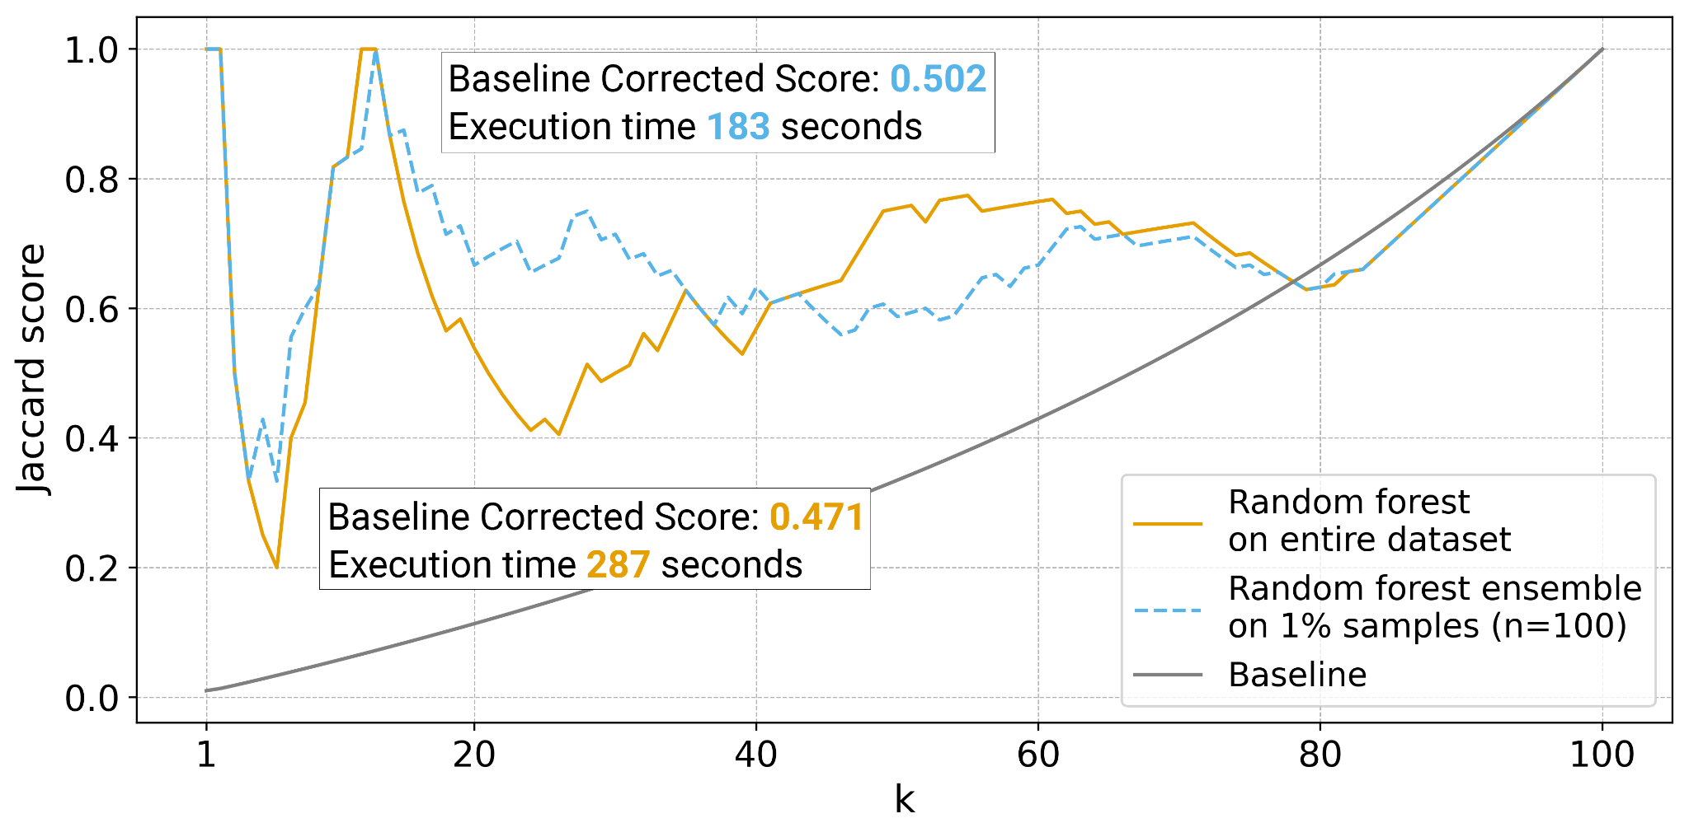
Conclusions
Same data
Faster execution
Better scores
Less uncertainty

